Slide 1


TEAM: ELECTIVE-NEEDED
Seismic Detection
Across the Solar System
A. Repetto - A. Lo Menzo – L. Braccani
M. Taborda - M. Mussi – R. Sagrera
ROSARIO - 5th and 6th of October 2024

Slide 2
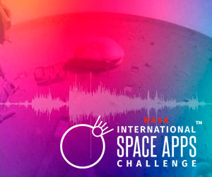
SEISMIC DETECTION
About
the Challenge
01
CHALLENGE
Planetary seismology missions face technical limitations in transmitting continuous data to Earth.
Only a small portion of the data is useful.
The challenge is to program a module to filter out the noise and transmit only the relevant data.
Real data from NASA’s Apollo (Moon) and InSight (Mars) missions is analyzed to detect seismic activity.

Slide 3
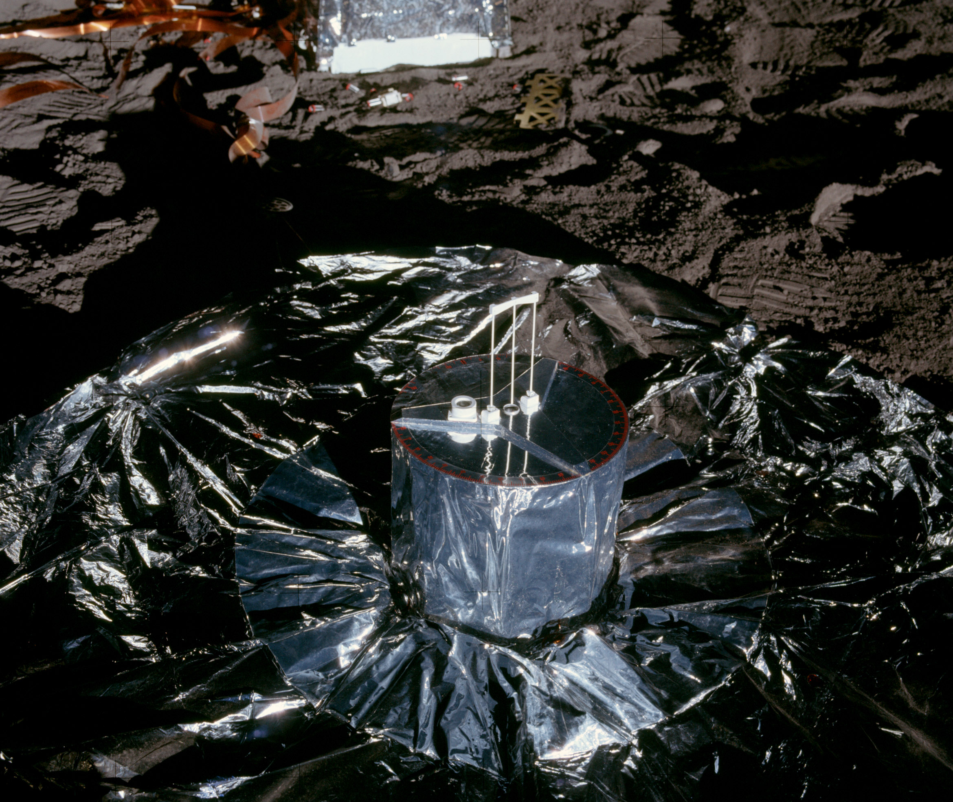
SEISMIC DETECTION
Identified
Problem
02
CONTEXT
Transmitting data from distant bodies requires increasing energy consumption with distance.
Earthquakes are rare events, so only a small portion of the transmitted data is relevant.
Scientific teams transfer large volumes of data from other disciplines, each with different goals and instruments.
Seismologists must work with fewer instruments or lower resolution, limiting scientific results and development.

Slide 4
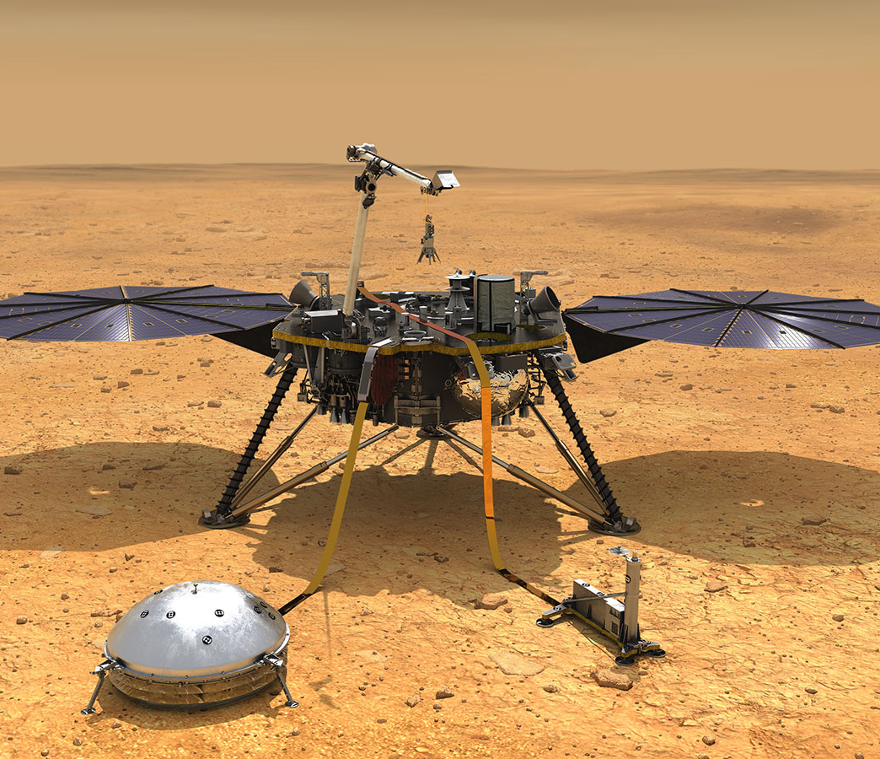
03
SEISMIC DETECTION
Proposed
Solution
Run on-site algorithms to differentiate seismic data from noise, so only useful signals are extracted and sent to Earth.
The necessary software and hardware for this solution are already developed with low development, operational, energy, spatial, and time costs.
It maximizes the utility and quality of the transmitted data.
APPROACH

Slide 5

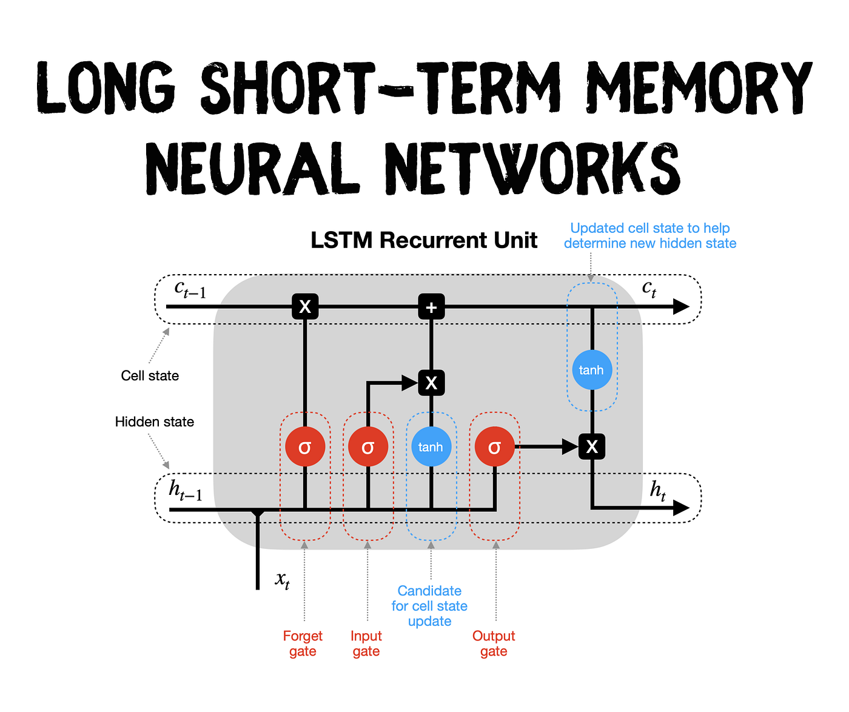
SEISMIC DETECTION
Deep Learning
Model
04
DATA PROCESS
The LSTM (Long Short-Term Memory) architecture is a type of recurrent neural network designed to process sequences of data.
It has the ability to retain relevant information over long periods, making it ideal for seismic data processing.

Slide 6
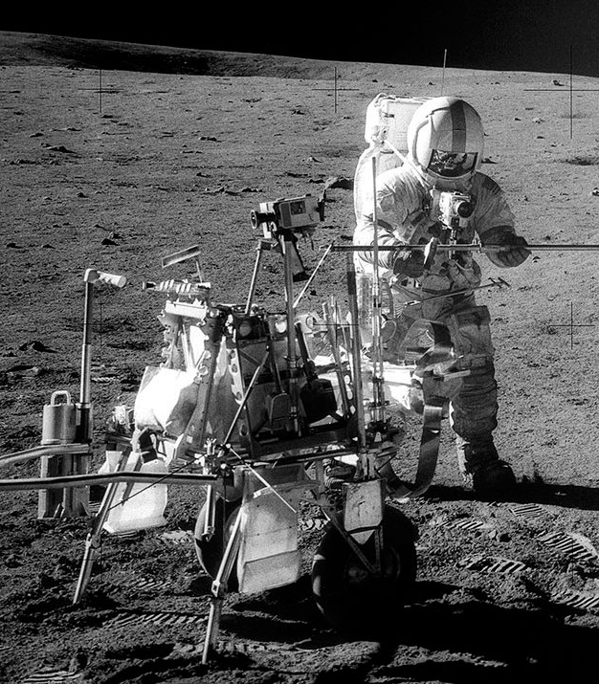
05
SEISMIC DETECTION
Impact and Relevance
The developed technique is not only applicable to space missions but also holds great potential for seismic activity detection on Earth with a predictive focus.
It could significantly reduce humanitarian, economic, and ecological losses by enabling early warning and anticipation of natural disasters.
GROUTH

